Slide 1
Perimeter Trap Crops Using Chicken Tractors
Gary Wenig – Rocky Creek Valley Farm, SARE Grant Number FNC13-938
Jaime C. Piñero Ph.D. – Lincoln University
NCR-SARE’s Farmers Forum, 2016

Slide 2
All Natural Sustainable Agriculture
Rocky Creek Valley Farm – Gary Wenig

Slide 3
Trap Crops
Sorghum Sudan Grass
Buckwheat
Millet
Fennel, dill, yarrow, coriander, tansy, buckwheat & millet attracts lady bugs, lacewing, hover flies, parasitic mini-wasps, tachinid flies. These are beneficial insects that kill the bad pests in your garden.

Slide 4
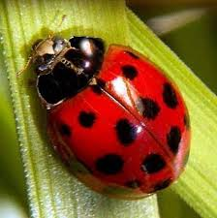
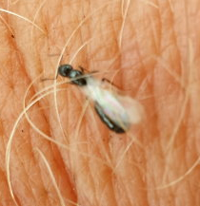
Beneficial Insects
Parasitic mini-wasps
Ladybug
Millet at maturity

Slide 5
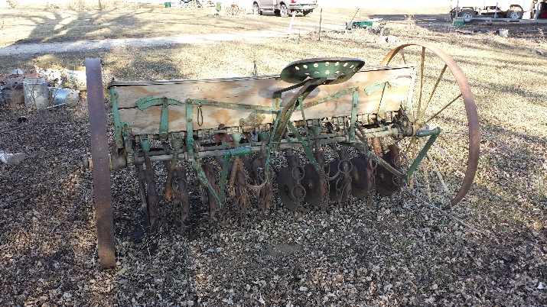
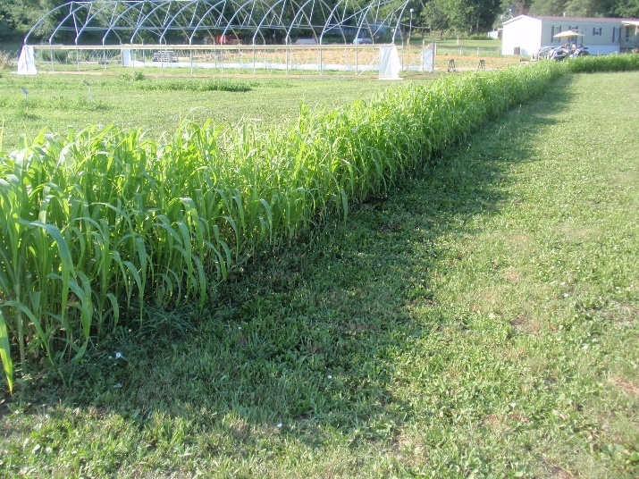
Prep & Planting
Millet, Buckwheat, Sorghum Sudan Grass

Slide 6
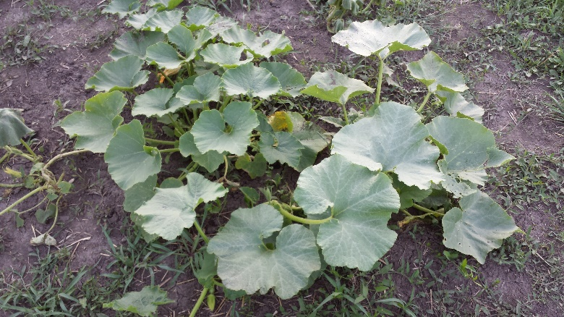
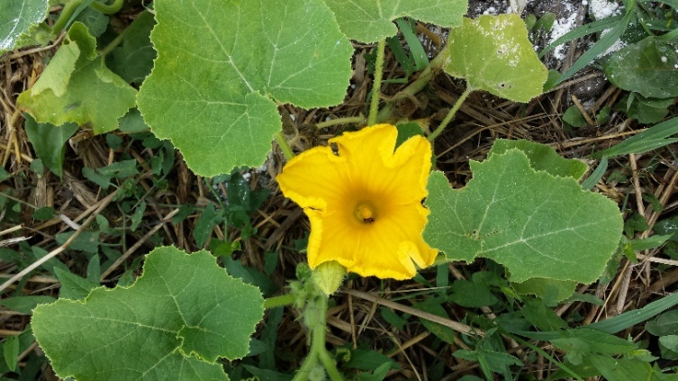
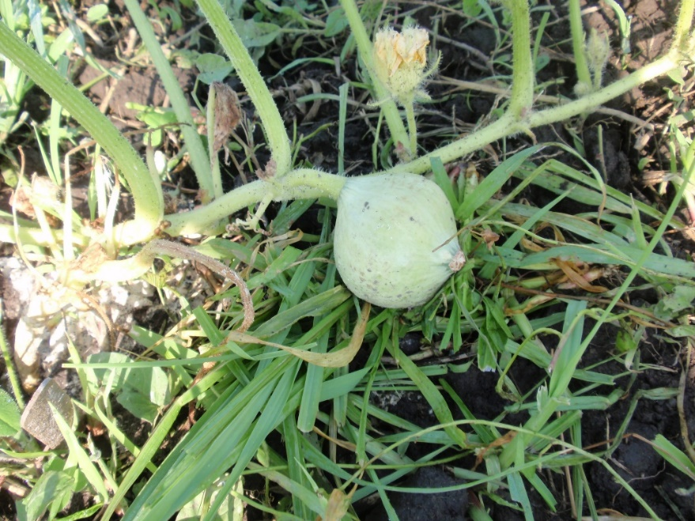
Blue Hubbard Sacrificial Plants
Attracts:
squash bugs & cucumber beetles

Slide 7
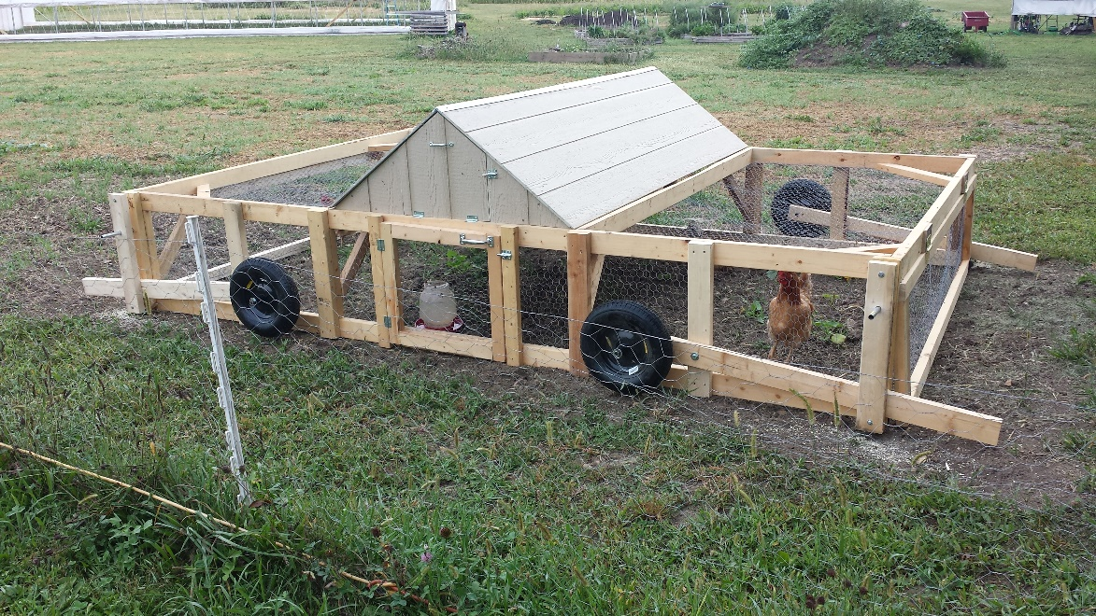
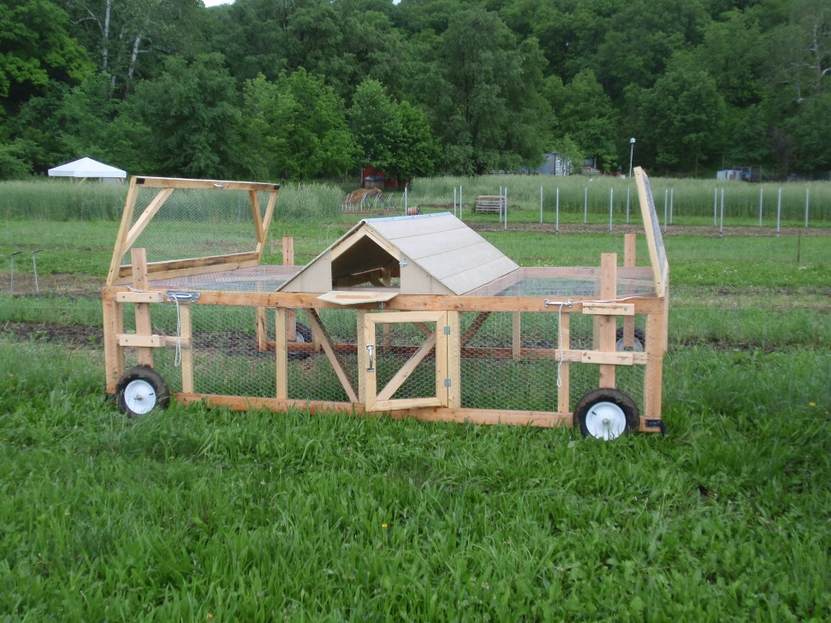
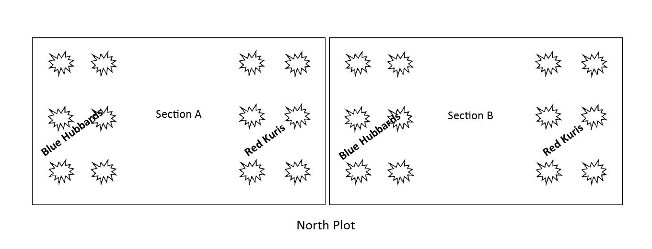
Planting Guide

Slide 8
Reduced Pesticide Usages
Squash bug eggs
Procedural issue resolved
Reconstruct the experiment
Ghost pepper experiment

Slide 9
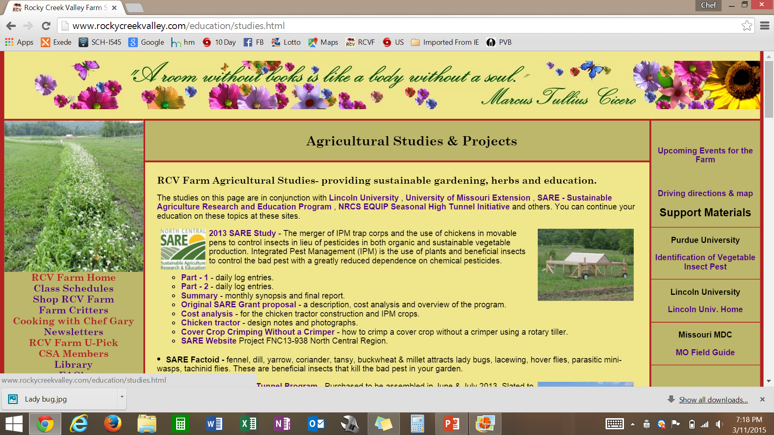
www.RockyCreekValley.com

Slide 10
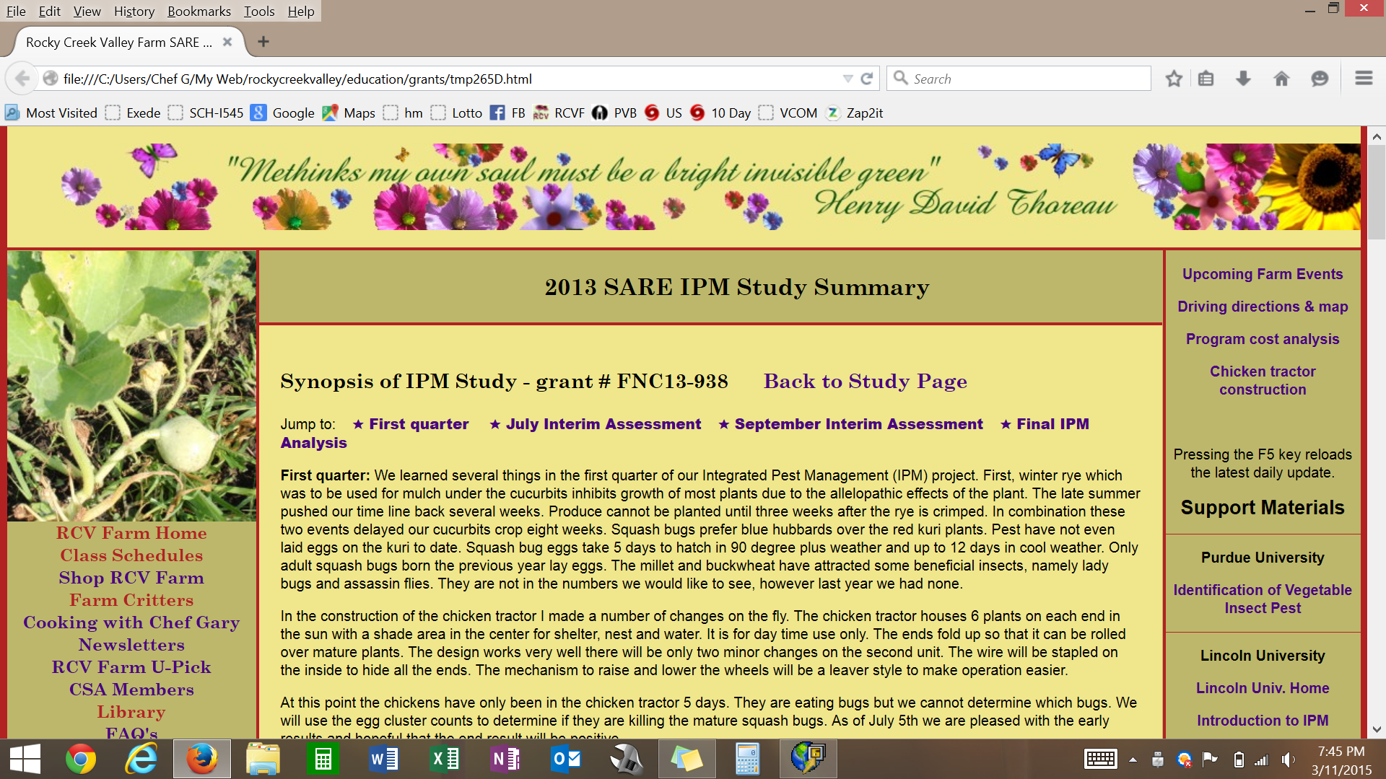
www.RockyCreekValley.com

Slide 11
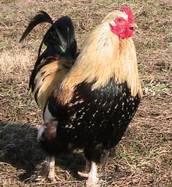
SARE IPM Summary
Perimeter trap crops are a 100% success story
Provides several alternative methods for pest control
Greatly reduces pesticide usage
Highly beneficial to certified organic growers
Overall our IPM test was a great success
Thanks to: Dr. Pinero, Jacob Wilson, Susan Jaster

Slide 12
IPM Test Phase II
Concept: place the free range chickens in a permanent pen surrounding the garden plots with trap crops and sacrificial crops in the pen.
Buckwheat, Millet, Yarrow, Tansy, etc.
Blue Hubbard
Cherry Tomatoes

Slide 13
Perimeter Trap Crops
Rocky Creek Valley Farm
Questions

